Slide 1
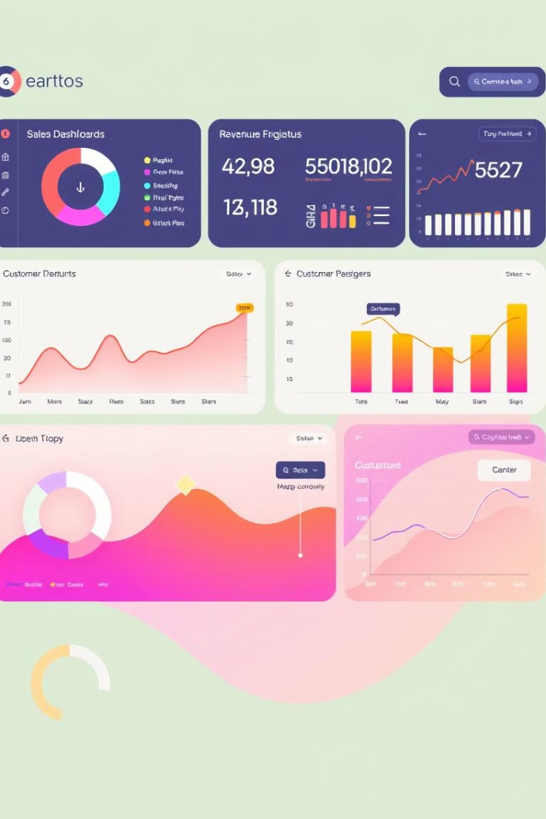
Q1 2025 Sales Performance Analysis
This presentation outlines the business requirements for the Q1 2025 Sales Performance Analysis Report, which aims to analyze product sales performance on Amazon based on available data, providing insights into key factors influencing revenue, sales volume, and customer engagement.

Slide 2
Project Objectives
Data Preparation
Sales Analysis
Clean and preprocess the dataset to ensure data quality. This includes removing duplicates, handling missing values, and converting data types.
Identify key sales trends and patterns, analyze factors affecting sales, such as discounts, ratings, and product categories, and generate insights for business decision-making.

Slide 3

Team Structure & Responsibilities
Team Lead
Data Engineers
Data Analysts
BI Developers
Responsible for Guiding and Checking Updates Regarding Project and Motivating team to achieve goal ,Solving conflicts and clashes among team members.
Responsible for data cleaning and preparation, including handling duplicates, missing values, and data type conversions.
Perform exploratory data analysis (EDA) and identify key insights, including sales trends, pricing impact, and rating influence.
Build visualizations and dashboards to present insights, including interactive charts, graphs, and reports.

Slide 4
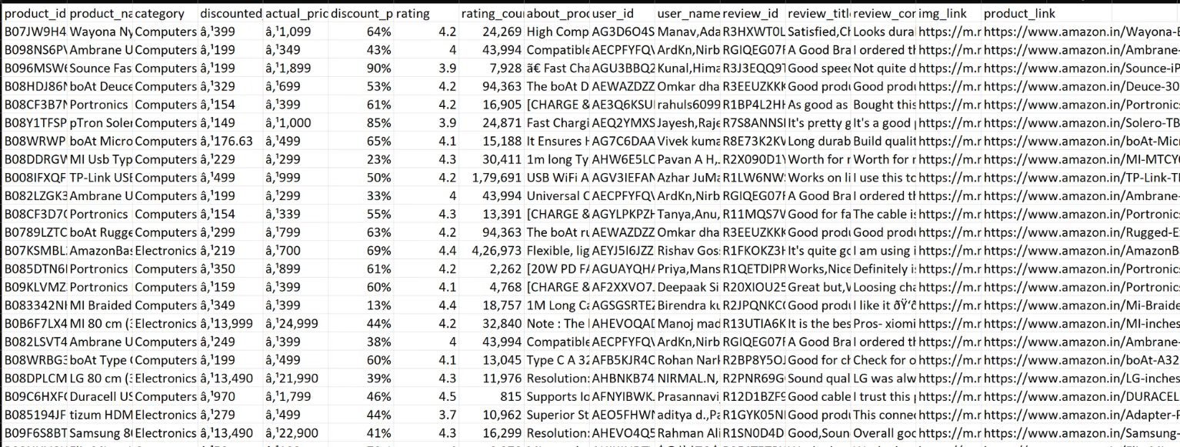
Unprepared Datasets of Amazon
This is the Unprepared Datasets of amazon which need to be clean,and organize to calculate the performanse analysis of Quarter 1 2025. Let suppose —

Slide 5
Data Cleaning Process…
Remove that Column Which is not useful to analyse the sales performance.
about_product,user_id,user_name,review_id,review_title,review_content,img_link,product_link remove all these column
Cleaned Discount_prize,Actual_prize,Discount _percentage column.
Change the Category name by this formula
=LEFT (ColumnName :SEARCH("|",ColumnName & "|",)-1)
it will sort the category .
5. Convert pricing and discount fields into numerical values.
6. Perform data consistency checks to remove duplicates and inconsistencies.
7. Add the Rating Higher/Lower/Average using If formula
=IF(Range>=4,"Higher",IF(Range>=3,"Average","Lower"))

Slide 6





Assumptions & Constraints
Sales Data
Conversion Factor
Actual sales data is not available, and sales volume is estimated using rating count.
Conversion factor (10) is assumed for estimating sales from ratings.
Missing Values
Data Accuracy
Some missing values are handled using average-based imputation.
Data accuracy depends on the quality of the Amazon dataset.

Slide 7

Sales Estimation & Revenue Calculation
Since actual sales quantity is not available, an estimated sales quantity is calculated using: Estimated Sales = rating_count * Conversion Factor (10). Total revenue is calculated using the formula: - Total Revenue = Discounted Price * Estimated Sales Count.

Slide 8
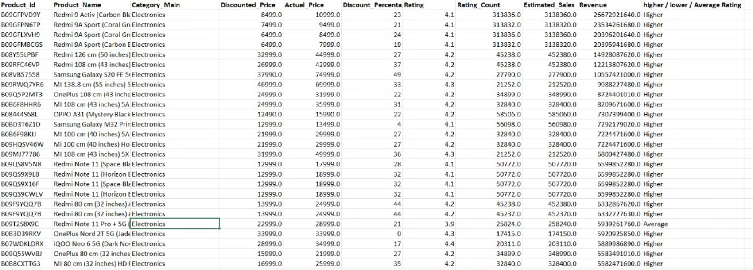
Cleaned And Prepared Data Set For Analysis

Slide 9
Sales Analysis Insights
Top Revenue Categories
Highest Discounted Categories
The top 5 revenue-generating categories are Electronics, Home & Kitchen, Computers & Accessories, Musical Instruments, and Office Products.
The highest discounted categories are Home Improvement, Computers & Accessories, Health & Personal Care, Electronics etc.

Slide 10
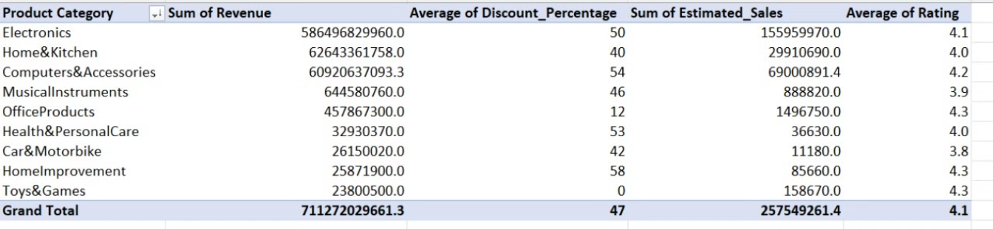
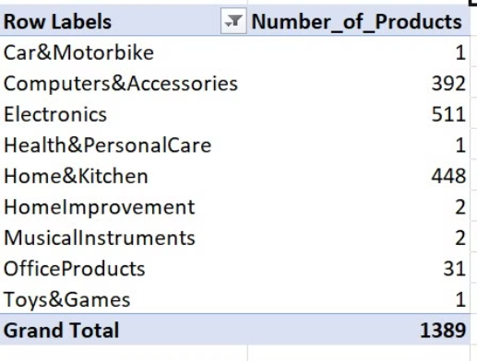
Pivot Table
No of items in Ecah Category

Slide 11
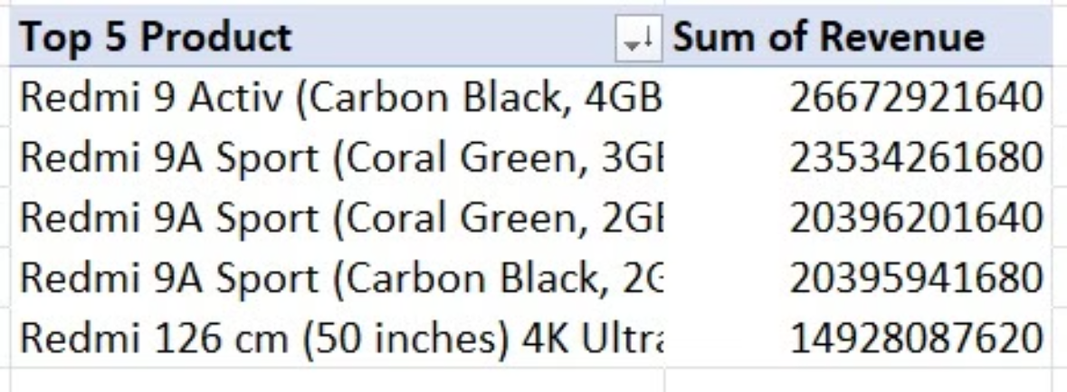
Top 5 Product
Formula =FILTER(Total_Table_Range, Range>=LARGE(Range,5))

Slide 12
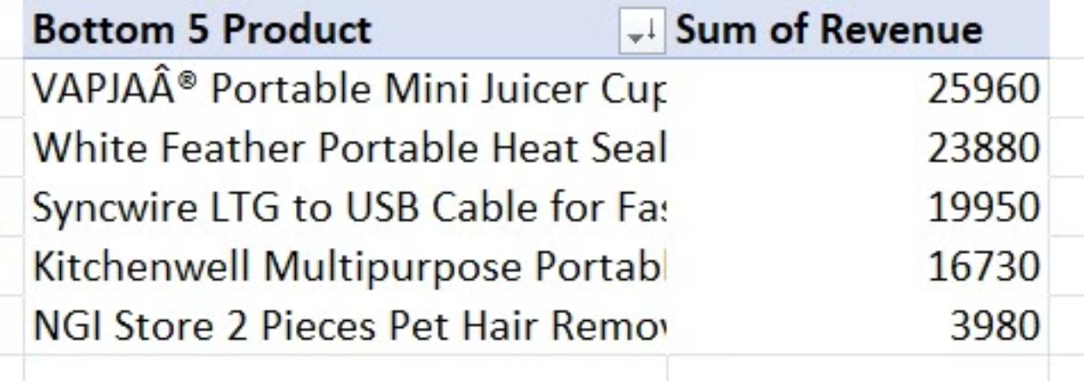
Bottom 5 Product and Their Category
Formula =FILTER(Total_Table_Range , Range<=SMALL(Range,5))

Slide 13
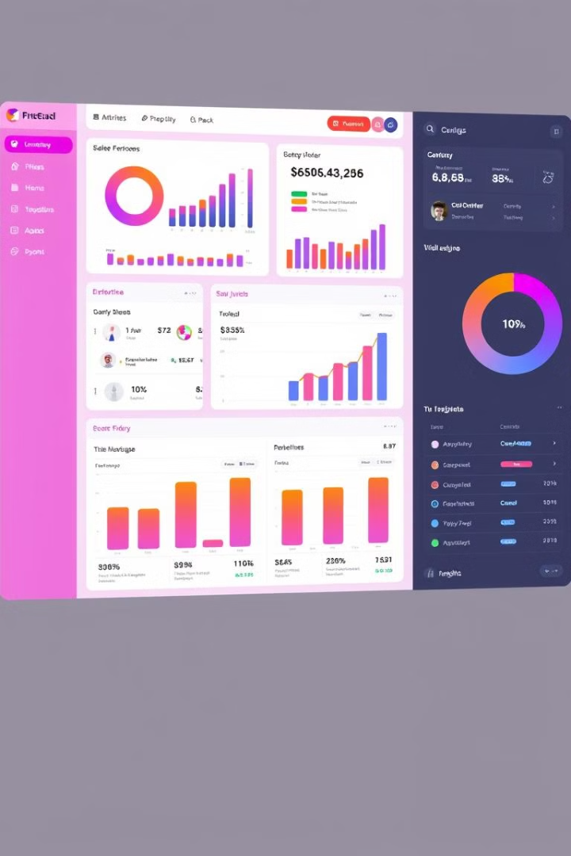
Dashboard & Reporting
The dashboard will display key sales metrics in an interactive format, providing insights into top-performing and bottom-performing products, allowing for category-wise and rating-based filtering.

Slide 14
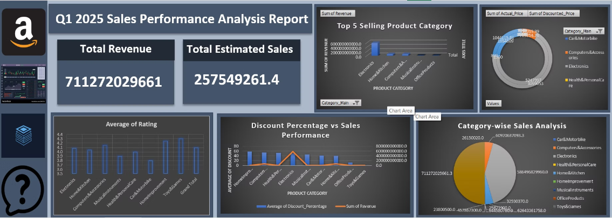
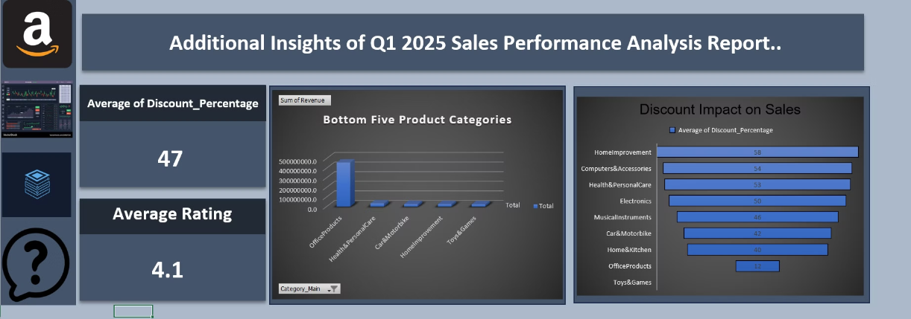
DashBoard View

Slide 15
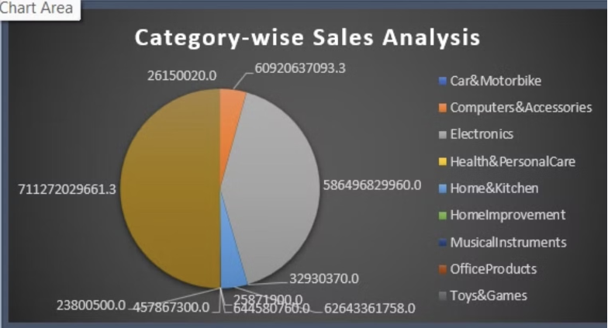
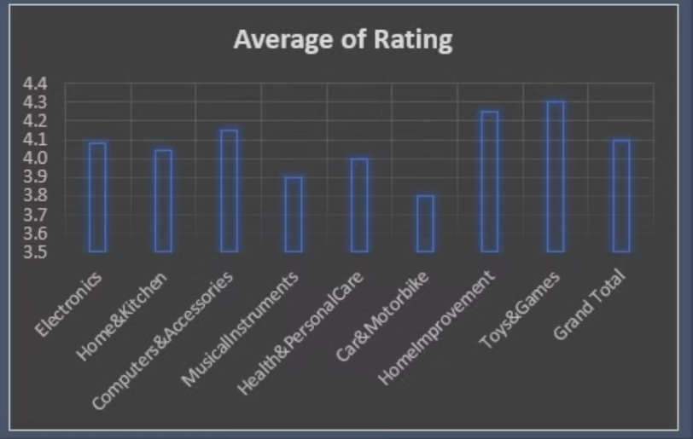
Sales By Category
Product Sales By Rating

Slide 16
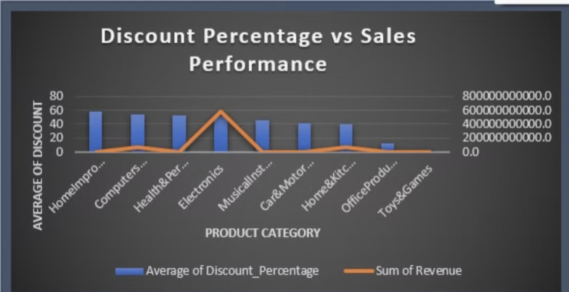
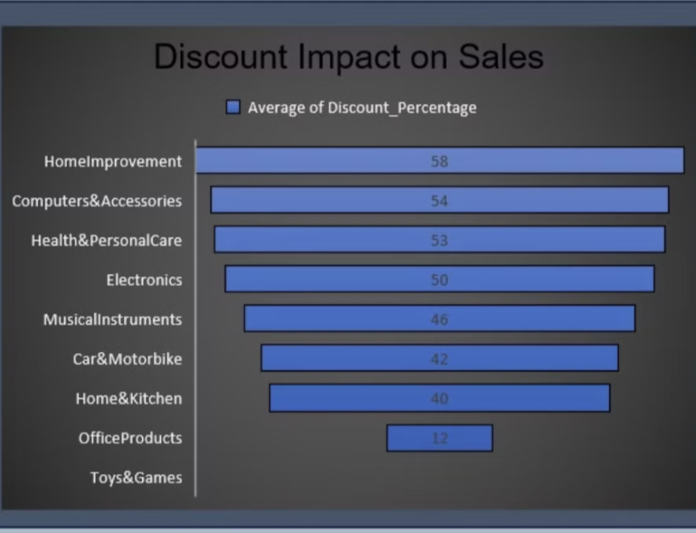
Discount impact on Sales Category Wise
Discount Impact

Slide 17
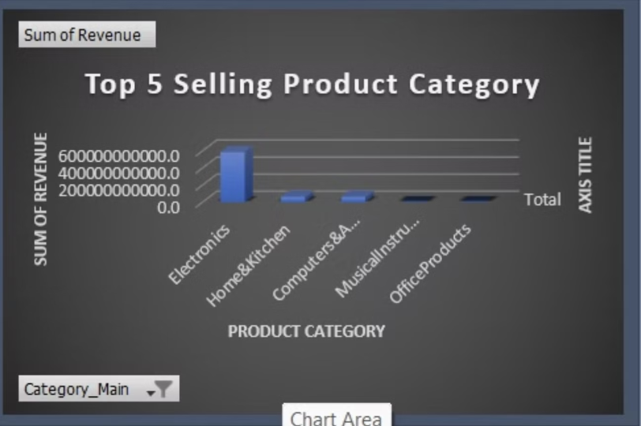
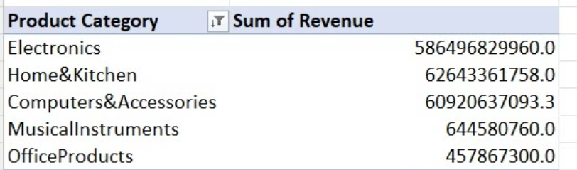
Top 5 Selling Product By Category

Slide 18
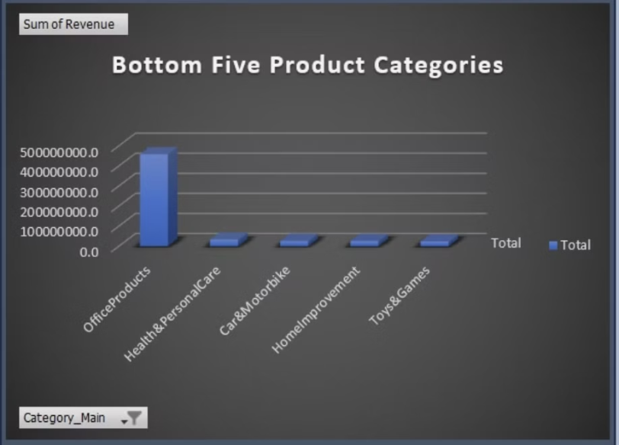
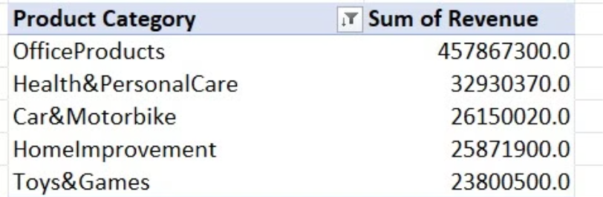
Bottom 5 Selling Product by Category

Slide 19




Success Criteria
Sales Report
Actionable Dashboard
Key Trends Identified
Improved Strategy
Generation of the Q1 2025 Sales Performance Report.
Dashboard provides actionable insights for decision-making.
Identification of key trends in sales, pricing, and ratings.
Improvement of business strategy based on report findings.

Slide 20
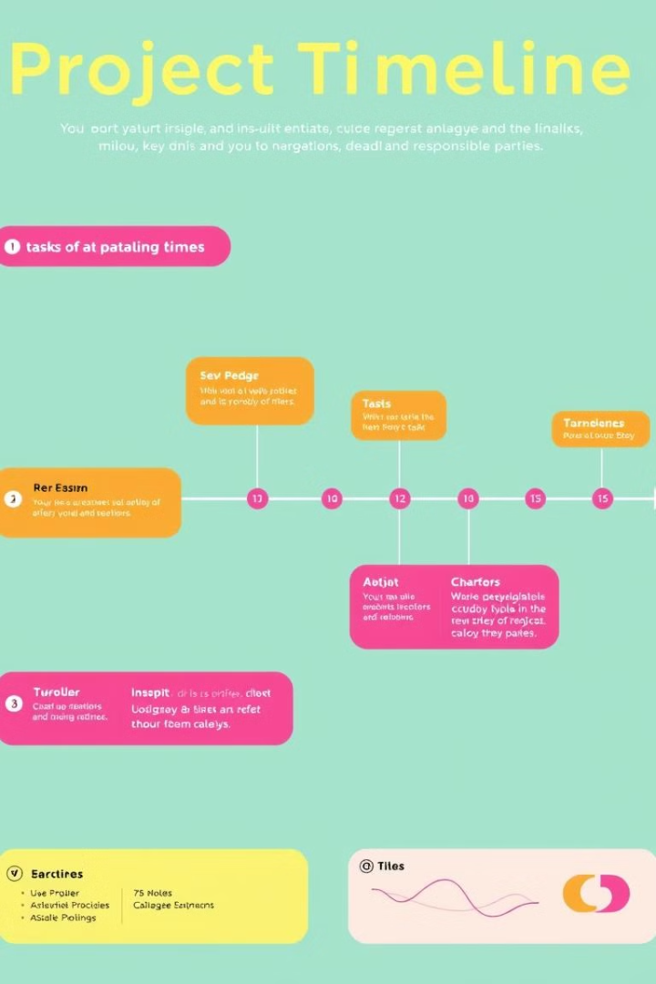
Deliverables & Timeline
Task
Responsible
Deadline
Data Cleaning
Data Engineers
23-02-25
Data Analysis
Data Analysts
24-02-25
Dashboard Development
BI Developers
24-02-25
Final Report Submission
Team Lead
25-02-25

Slide 21
Conclusion
The scope, objectives, and methodology for analyzing Q1 2025 Amazon sales performance disclose the sales and revenue growth. The project aims to derive meaningful insights to assist in business decision-making by leveraging data cleaning, sales estimation, and BI visualization techniques.
Thank You…

